Slide 1
Cyber Crime dataset questions
By
Akhilesh T S
SASTRA University
tsakhilesh12@gmail.com
9445769936

Slide 2
Dashboard generated

Slide 3
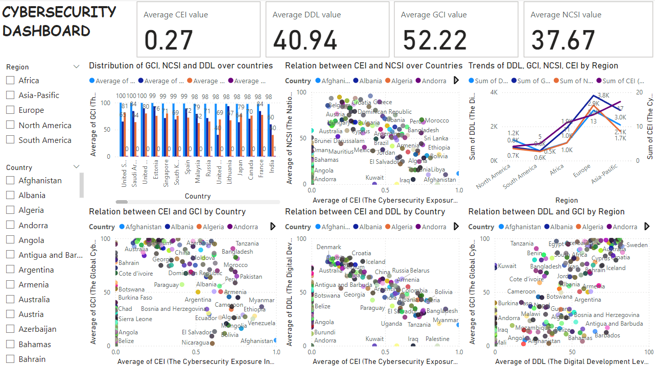

Slide 4
Questions about the Dataset

Slide 5
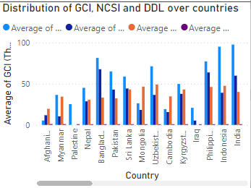
Question 1. Which country in the Asia-Pacific region has the highest CEI score, and how does its GCI and NCSI compare to other countries in the same region?
Afghanistan has the highest CEI value in the Asia-Pacific region compared to other countries
It has less GCI and NCSI value as compared to other countries

Slide 6
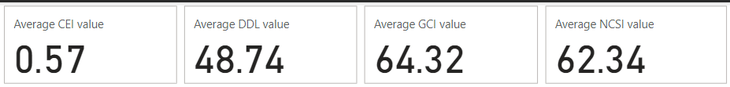
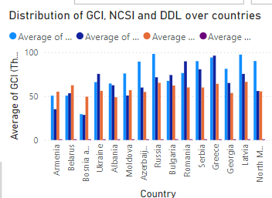
Question 2. How does Albania's cybersecurity metrics (CEI, GCI, NCSI) compare to other European countries?
Albania has CEI of 0.57, DDL of 48.74, GCI of 64.32 and CSI of 62.34
It has moderate to good cybersecurity measures as compared to other countries in the European region

Slide 7
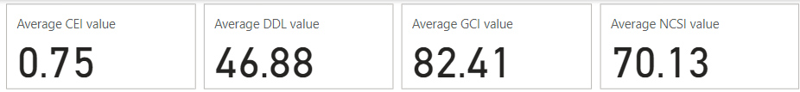
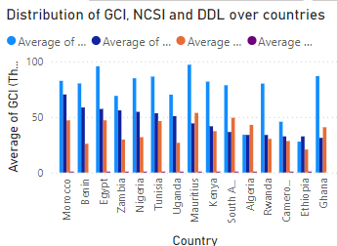
Question 3. Which country in Africa has the highest NCSI and how does its DDL relate to its other cybersecurity indicators?
Morocco has the highest NCSI value of 70.13 in the Africa region
Morocco has a high DDL value of 46.88 as compared to the average of 19.71 of the Africa region

Slide 8
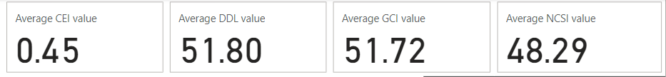
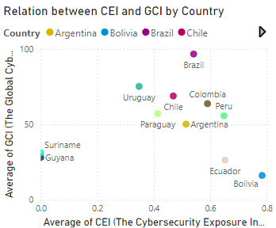
Question 4. What is the relationship between CEI and GCI for countries in South America?
Countries in South America have an average CEI of 0.45 and average GCI of 48.29
Countries like Uruguay, Chile, Colombia, Peru, Paraguay have a good value of CEI against the GCI value

Slide 9
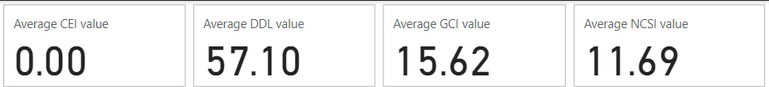
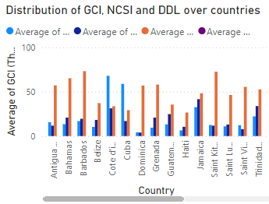
Question 5. Which countries in North America have the lowest Cybersecurity Exposure Index (CEI), and how does it relate to their GCI and NCSI?
Antigua and Barbuda has the lowest CEI value with 0.0, GCI of 15.62 and NCSI of 11.69
The average values in North America with GCI of 32.78 and NCSI of 29.44
It has high DDL value as compared to other countries

Slide 10
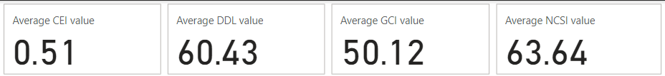
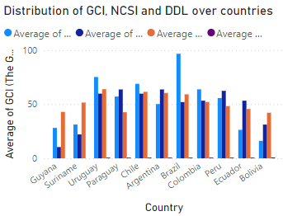
Question 6. How does Argentina's NCSI score compare with other South American countries, and what trends can be observed?
Argentina has a NSCI score of 63.44 compared to average of 48.29 against countries in South America
Argentina NSCI score is higher than the average NSCI score of the other countries in South America

Slide 11
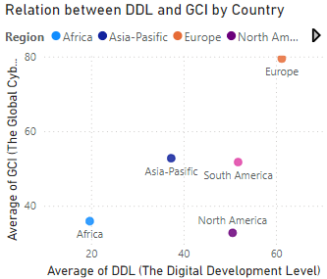
Question 7. What is the correlation between Digital Development Level (DDL) and Global Cybersecurity Index (GCI) across different regions?
Countries in European region have high GCI and DDL values compared to countries in African region with low GCI and DDL values
Countries in Asia-Pacific, South America and North America fall in the median range of values

Slide 12
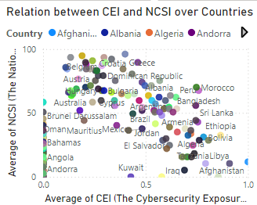
Question 8. Which countries exhibit a high CEI but low NCSI, and what does that imply about their cybersecurity status?
Countries like Libya, Afghanistan and Tanzania have high CEI values as compared to their NCSI values
A higher CEI (Cybersecurity Exposure Index) combined with lower NCSI (National Cyber Security Index) suggests a concerning mismatch between a country’s cybersecurity exposure and its cyber defense capabilities

Slide 13
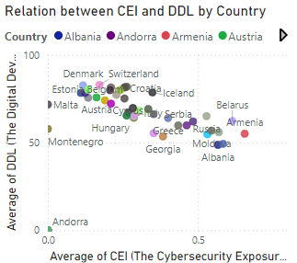
Question 9. How do countries in Europe compare in terms of CEI vs. DDL levels? Are there any clear patterns or anomalies?
Countries in Europe have higher CEI value against moderate to high DDL values
There is a clear pattern with a few countries like Andorra, Montenegro expressing anomalies

Slide 14
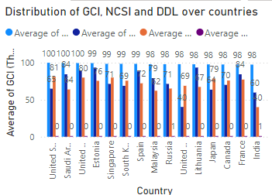
Question 10. What are the top 5 countries with the highest GCI scores globally, and what are their CEI and NCSI values?
Top 5 countries with high GCI values are USA, Saudi Arabia, UK, Estonia and Singapore
Their CEI and NCSI values can be derived from the chart

Slide 15
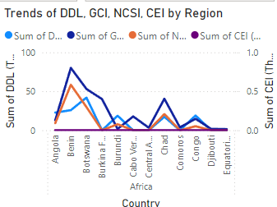
Question 11. What is the regional distribution of countries with a CEI of 0, and what could explain the cybersecurity status in those regions?
The chart represents the relation between countries with 0 CEI value and other factors
It shows a high rate of imbalance in the values of DDL, GCI and NCSI against the CEI values

Slide 16
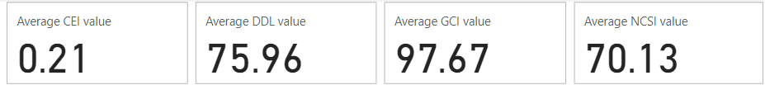
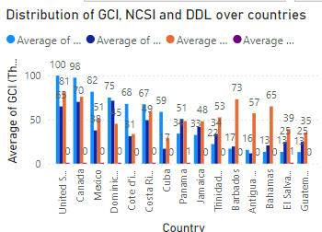
Question 12. How does Canada's GCI compare with other North American countries, and what factors contribute to its ranking?
Canada has a CEI value of 0.21, DDL value of 75.96, GCI value of 97.67 and NCSI value of 70.13
It has higher GCI, DDL and NCSI values contributing to its higher ranking

Slide 17
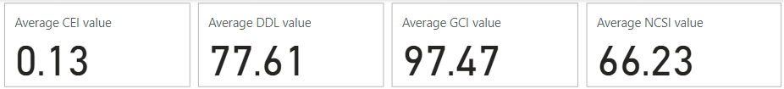
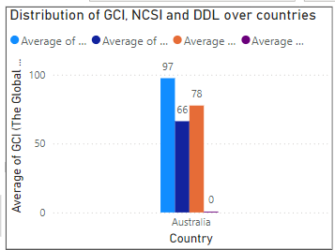
Question 13. What can be inferred about the cybersecurity state of Australia based on its CEI, GCI, NCSI, and DDL?
Australia has a high CEI value of 0.13, DDL value of 77.61, GCI value of 97.47 and NCSI value of 66.23
Its high GCI, DDL and NCSI values contribute to high cybersecurity measures

Slide 18
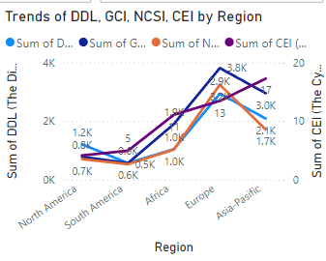
Question 14. What patterns emerge when comparing CEI scores across different regions (Africa, Europe, Asia-Pacific, etc.)?
CEI scores of North America is lowest with 0.17 against the Asia-Pacific region of 0.31
The chart shows the representation of metrics against the regions

Slide 19
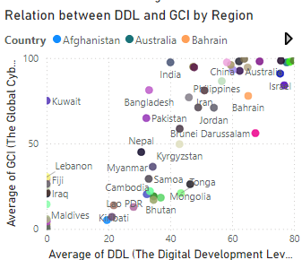
Question 14. How does the Digital Development Level (DDL) impact the GCI scores within the Asia-Pacific region?
DDL value in Asia-Pacific region stands at 37.33 with GCI value of 52.76
Countries like Australia, China, Israel have high values of DDL and GCI

Slide 20
Analysis Questions

Slide 21
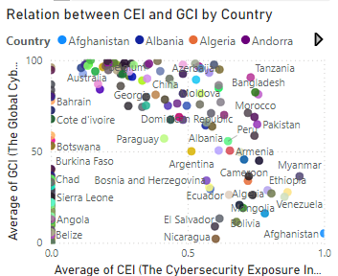
Question 1. Correlation Analysis: Is there a strong correlation between Digital Development Level (DDL) and Global Cybersecurity Index (GCI) across all countries?
There is a strong correlation between DDL and GCI except a few outliers

Slide 22
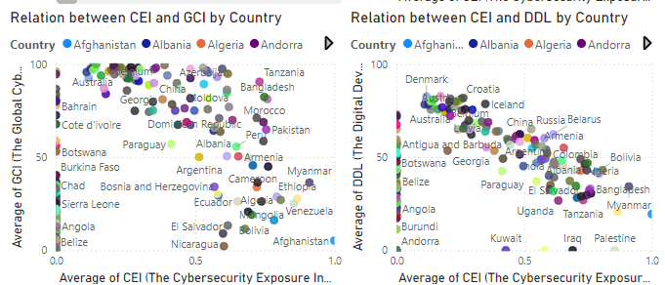
Question 2. Cluster Analysis: Can countries be clustered into groups based on their CEI, NCSI, and GCI scores?
Countries can be clustered together based on their relations
As the values of CEI and GCI increase, so does the relation
Similarly it works with CEI and DDL

Slide 23
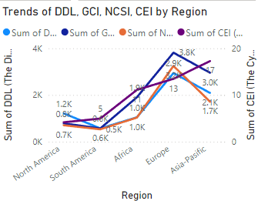
Question 3. Regional Comparisons: Which region performs best overall in terms of NCSI scores, and what regional trends can be observed?
Europe region performs best in terms of NCSI scores
It has high NCSI, CEI, DDL and GCI scores as compared to other countries

Slide 24
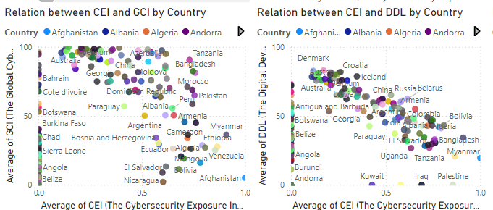
Question 4. Outlier Analysis: Identify countries with extremely high CEI but low GCI or NCSI and investigate the reasons behind these outliers.
Countries like Afganisthan, Myanmar have high CEI but low GCI
Similarly, countries like Palestine, Myanmar, Bangladesh have high CEI as compared to low DDL
Reasons could be poor infrastructure in cyber security and the presence of unstable politics

Slide 25
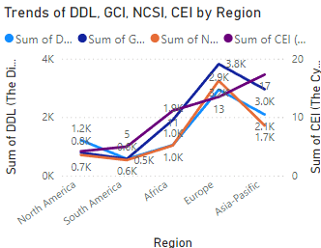
Question 4. Trend Analysis: Explore how Digital Development Level (DDL) trends with Cybersecurity Exposure Index (CEI) across different regions.
DDL is high compared to CEI in Europe
In North America, both the values are low

